Slide 1
Professional CSS
Things you wish your mother would have told you about CSS before you learned the hard way.
Tips and best practices
By Steven King
Credit: Many tips from post by Glen Stansberry
http://net.tutsplus.com/tutorials/html-css-techniques/30-css-best-practices-for-beginners/

Slide 2
Make it readable
The readability of your CSS is incredibly important for you to work faster now and fixing things in the future
For me to grade it or your boss to do a code review
For other developers
Make multiple line styles
.someDiv {
background: red;
padding: 2em;
border: 1px solid black;
}

Slide 3
Create Your HTML First
You save time if you create the entire HTML mockup first.
Because you know all the elements of your site layout, but you don’t know what CSS you’ll need with your design

Slide 4
Use the Right Doctype
The doctype declaration matters a whole lot on whether or not your markup and CSS will validate. In fact, the entire look and feel of your site can change greatly depending on the DOCTYPE that you declare.
I use HTML5 now.
<!DOCTYPE html>

Slide 5
Understand the Difference Between Block vs. Inline Elements
Block elements are elements that naturally clear each line after they’re declared, spanning the whole width of the available space. Inline elements take only as much space as they need, and don’t force a new line after they’re used.
Block
div, h1...h6, p, ul, li, table, blockquote, pre, form
Inline
span, a, strong, em, img, br, input, abbr, acronym

Slide 6
Keep it Consistent
You should start to develop your own “sub-language” of CSS that allows you to quickly name things
Consistent style naming convention
.my-style{}
.myStyle{}
.my-Style{}
I can’t remember??
I use: .my-style{};

Slide 7
Organize the Stylesheet with a Top-down Structure
It always makes sense to lay your stylesheet out in a way that allows you to quickly find parts of your code. I recommend a top-down format that tackles styles as they appear in the source code.
Generic selectors
Structure IDs (top to bottom)
Classes below and with each related structure ID

Slide 8
Alphabetize your Properties
Seems small but on big projects, can be helpful.
#my-class {
color: #fff;
float: left;
font-weight:
height: 200px;
margin: 0;
padding: 0;
width: 150px;
}

Slide 9
Comment Everything
Just like any other language, it’s a great idea to comment your code in sections. To add a comment, simply add /* behind the comment, and */ to close it, like so:
/* Here's how you comment CSS */
/****** main content *********/
styles goes here...

Slide 10
Combine Elements
Elements in a stylesheet sometimes share properties. Instead of re-writing previous code, why not just combine them? For example, your h1, h2, and h3 elements might all share the same font and color:
h1, h2, h3 {
font-family: tahoma,
color: #333
}

Slide 11
Use Multiple (compound) Classes
it’s beneficial to add multiple classes to an element. Let’s say that you have a <div> “box” that you want to float right, and you’ve already got a class .right in your CSS that floats everything to the right. You can simply add an extra class in the declaration.
<div class="box right"></div>

Slide 12
Make Use of Generic Classes
You’ll find that there are certain styles that you’re applying over and over. Instead of adding that particular style to each ID, you can create generic classes and add them to the IDs or other CSS classes
.left {float:left}
.right {float:right}
<div id="coolbox" class="left">...</div>

Slide 13
Use Shorthand
You can shrink your code considerably by using shorthand when crafting your CSS. For elements like padding, margin, font and some others, you can combine styles in one line.
top, right, bottom, and left values, respectively.
#my-style {
margin-left: 5px;
margin-right: 7px;
margin-top: 8px;
}
#my-style {
margin: 8px 7px 0px 5px;}

Slide 14
Don’t Just Wrap a DIV Around It
There’s a temptation to wrap a div with an ID or class around an element and create a style for it.
<div class="header-text"><h1>Header Text</h1></div>
<h1>Header Text</h1>

Slide 15
Use Absolute Positioning Sparingly
It is a handy aspect of CSS that allows you to define where exactly an element should be positioned on a page. However the layouts can get quite hairy if there are multiple absolutely positioned elements running around the layout.
Also, hard to be responsive

Slide 16
Use EMs over Pixels
Pixels are a more static way to define font sizes, and ems are more scalable with different browser sizes and mobile devices. With the advent of many different types of web browsing (laptop, mobile, etc.), ems are increasingly becoming the default for font size measurements as they allow the greatest form of flexibility.

Slide 17
Don’t Underestimate the List
Lists are a great way to present data in a structured format that’s easy to modify the style. Thanks to the display property, you don’t have to just use the list as a text attribute. Lists are also great for creating navigation menus and things of the sort.

Slide 18
Validate Your HTML and CSS
Use a validator. I like w3c for CSS

Slide 19
Use Multiple Stylesheets
Just makes your life easier.
Depending on the complexity of the design and the size of the site, it’s sometimes easier to make smaller, multiple stylesheets instead of one giant stylesheet. Aside from it being easier for the designer to manage, multiple stylesheets allow you to leave out CSS on certain pages that don’t need them.

Slide 20
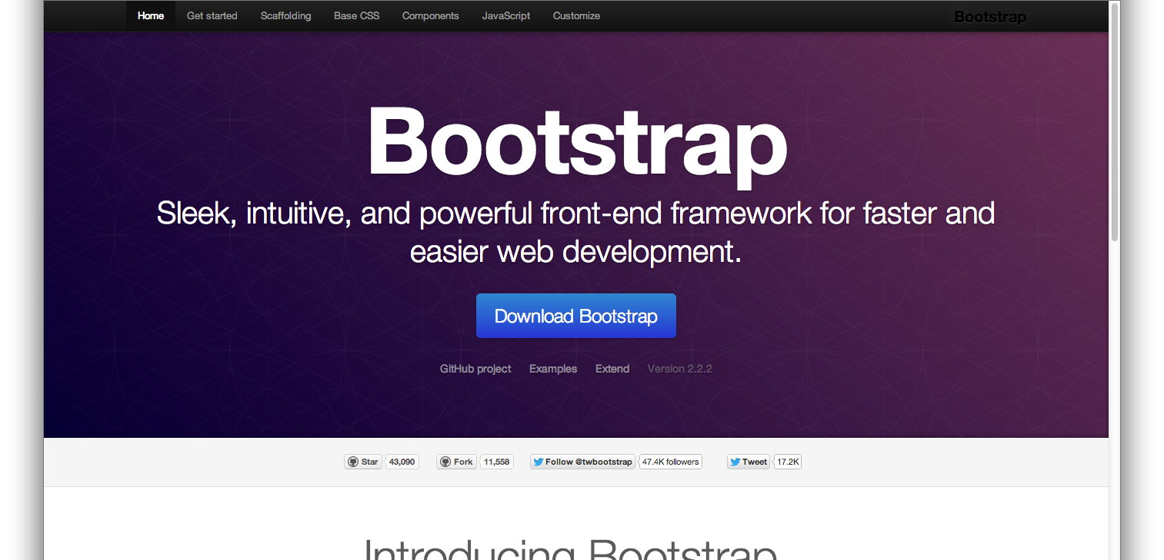
Let’s Get Responsive!

